Slide 1
Obesity Levels Prediction
Daud Rusyad Nurdin
DA/DS Bootcamp batch 34
Check-Point 2
Modelling Machine Learning

Slide 2
Table of Contents
01
Data Preparation Summary
02
03
Model Building
Streamlit App Dev
2
Summary of Data Understanding, Exploratory Data Analysis (EDA) and Data Preprocessing
Baseline model, candidate models: training, evaluation, tuning, testing → choose the best performance model
Development of the Streamlit-based app for predicting obesity levels

Slide 3
Objectives
To conduct an in-depth exploration of the obesity level dataset in order to identify and analyze the key factors that significantly influence an individual's level of obesity.
To develop and evaluate various machine learning models with the aim of determining the most accurate and reliable model for predicting obesity levels based on the given features.
To design and implement an interactive Streamlit-based application that integrates the selected machine learning model to predict an individual's obesity level according to user-provided input parameters.

Slide 4
01
Data Preparation Summary

Slide 5
Data Preparation Summary
5
Size
Class Balance
Rows: 2111 (24 duplicates) → Final: 2087
Columns: 17 (16 features, 1 target)
After encoding: 20 columns (19 features, 1 target)
Data is relatively balanced against the target variable
→ No resampling required
Outliers
Outliers are meaningful
→ No need to remove outlier data
Missing Values
None
Encoding
Data Duplicates
9 categorical columns were encoded
(label = 8, one-hot=1) .
24 rows
Multicollinearity
Scaling
None
→ Corr Heatmap, Cramér’s V Heatmap, VIF Score
Using Standard Scaler,
applied for models using distance-based calculations,
while tree-based models did not require scaling

Slide 6
02
Model Building

Slide 7
Machine Learning Models
7
Model | Category | Scaling?
Logistic Regression (multi_class='multinomial') | Linear | Yes
Ordinal Logistic Regression | Linear | Yes
Random Forest | Tree-based | No required
XGBoost Classifier | Tree-based | No required
LightGBM Classifier | Tree-based | No required
CatBoot Classifier | Tree-based | No required
Baseline: Logistic Regression
Candidates: the other models

Slide 8
Model Evaluation Setup
8
Data
Metrics
Train: 1669 (=80%)
Test: 418 (=20%)
Total: 2087 (=100%)
Precision
Recall
F1-Score
Accuracy
Cross Validation
Method: StratifiedKFold, K = 5

Slide 9
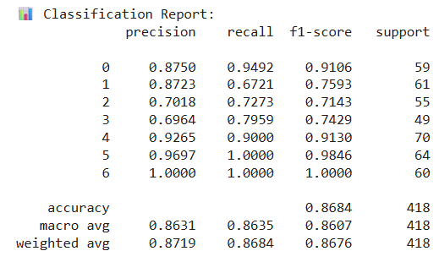
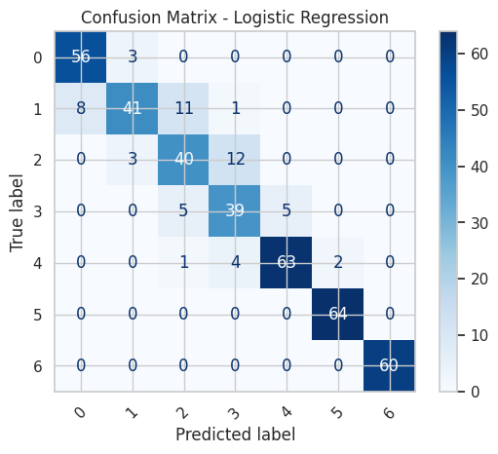
Logistic Regression
9
Test & Cross-Validation Accuracy
Test Accuracy: 0.8684
Cross-Validation Accuracy: 0.8610 ± 0.0160

Slide 10
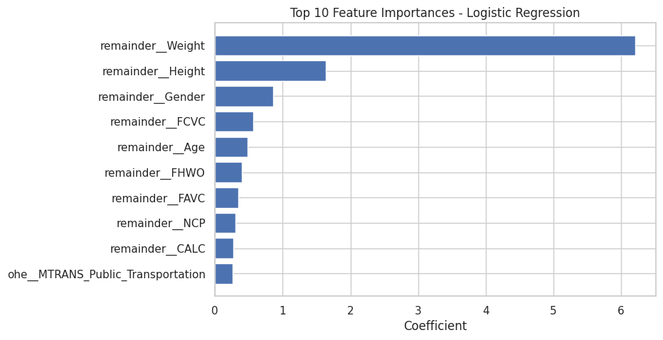
Logistic Regression
10
Top Feature Importances

Slide 11
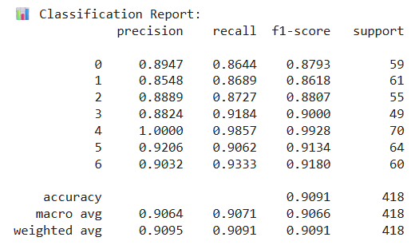
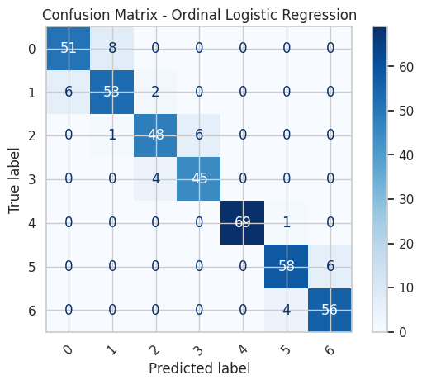
Ordinal Logistic Regression
11
Test & Cross-Validation Accuracy
Test Accuracy: 0.9091
Cross-Validation Accuracy: 0.8993 ± 0.0096

Slide 12
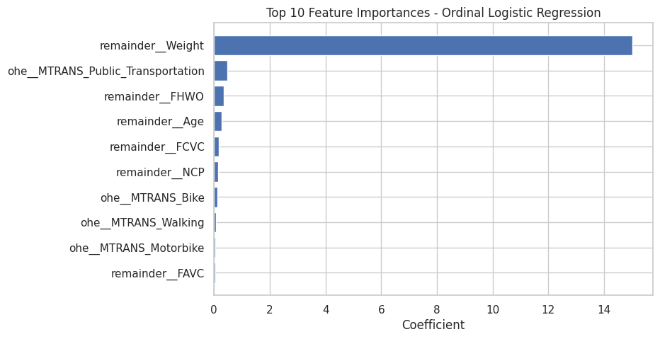
Ordinal Logistic Regression
12
Top Feature Importances

Slide 13
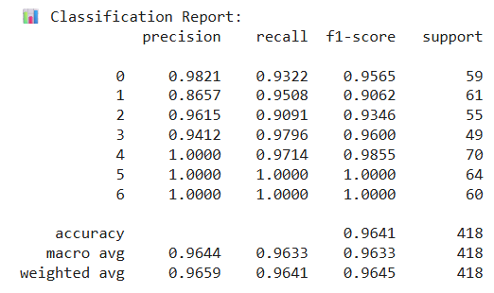
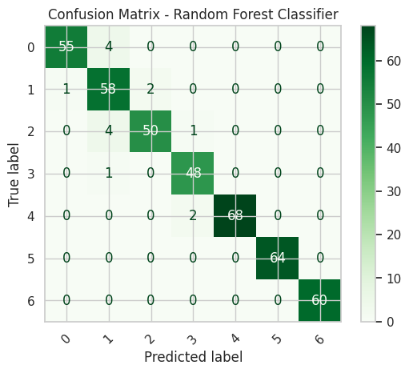
Random Forest
13
Test & Cross-Validation Accuracy
Test Accuracy: 0.9641
Cross-validation accuracy: 0.9461 ± 0.0132

Slide 14
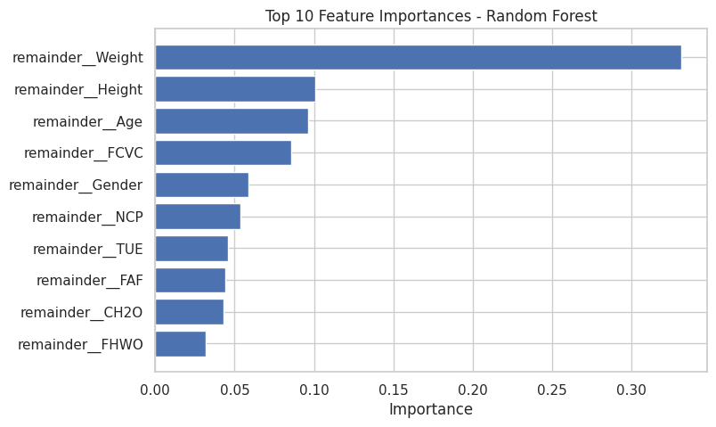
Random Forest
14
Top Feature Importances

Slide 15
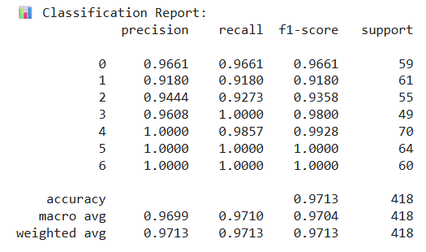
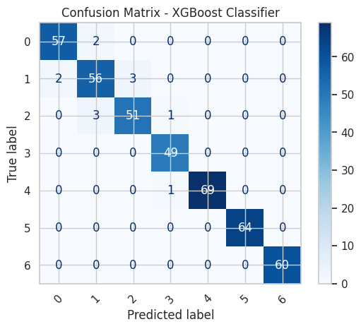
XGBoost Classifier
15
Test & Cross-Validation Accuracy
Test Accuracy: 0.9713
Cross-validation accuracy: 0.9676 ± 0.0035

Slide 16
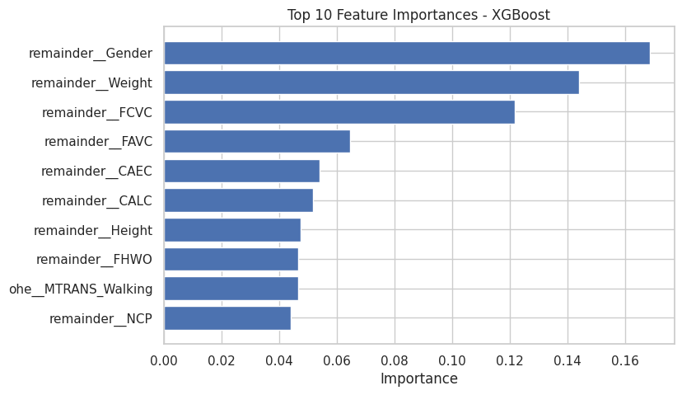
XGBoost Classifier
16
Top Feature Importances

Slide 17
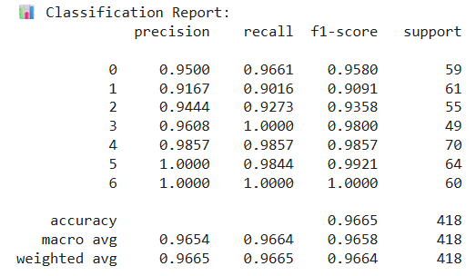
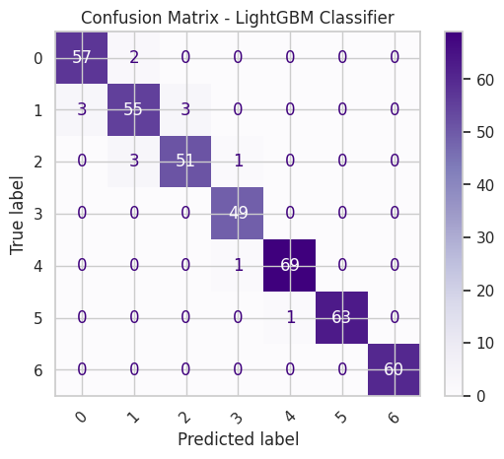
LightGBM Classifier
17
Test & Cross-Validation Accuracy
Test Accuracy: 0.9665
Cross-validation accuracy: 0.9700 ± 0.0033

Slide 18
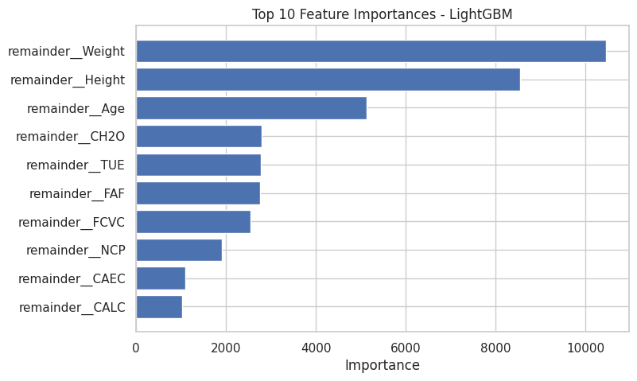
LightGBM Classifier
18
Top Feature Importances

Slide 19
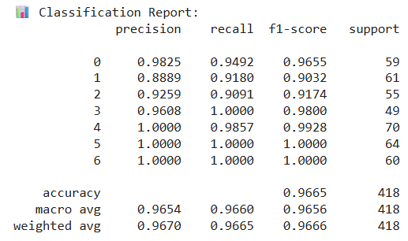
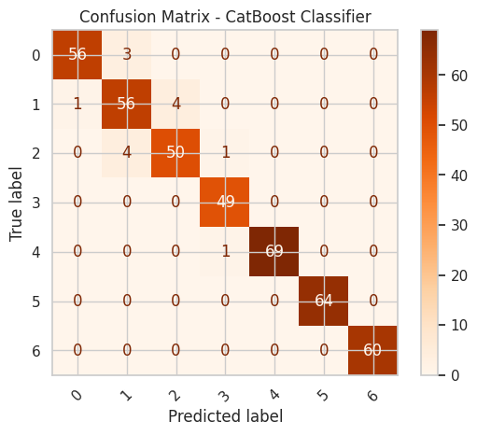
CatBoost Classifier
19
Test & Cross-Validation Accuracy
Test Accuracy: 0.9665
Cross-validation accuracy: 0.9587 ± 0.0087

Slide 20
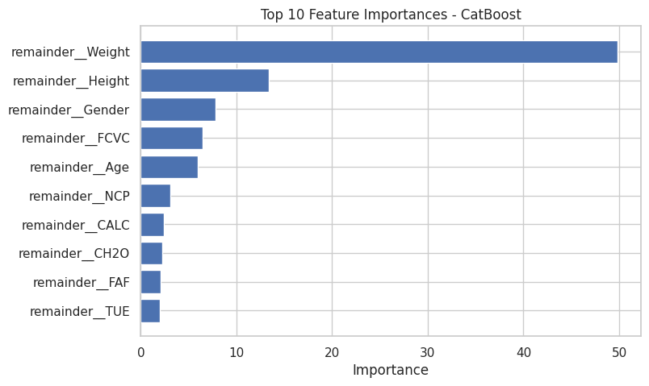
CatBoost Classifier
20
Top Feature Importances

Slide 21

Summary
21
Conclusion
XGBoost achieved the highest accuracy (97.13%) and the best F1-scores, making it the top-performing model.
LightGBM and CatBoost also performed well (~96.65% accuracy), slightly below XGBoost.
Random Forest offered good accuracy (96.41%) with faster training time.
Logistic Regression and Ordinal Logistic Regression were faster but less accurate.
Overall, XGBoost provides the best balance between accuracy and training time.

Slide 22
03
Streamlit App Development

Slide 23
Application Design
23
Side bar input parameter
Banner
Title
Tab menu
Info area
Button to execute prediction
Prediction Result
And other info

Slide 24
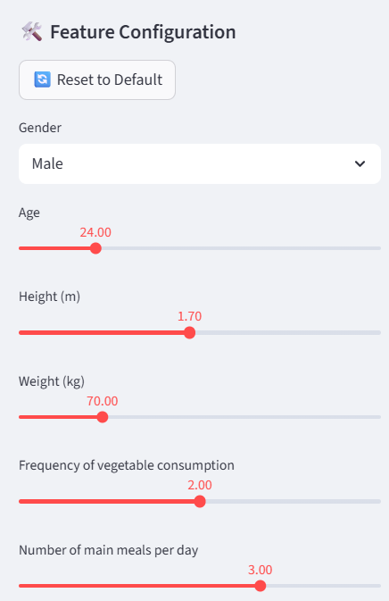


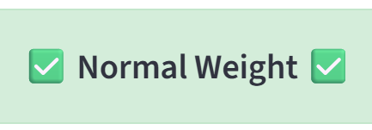
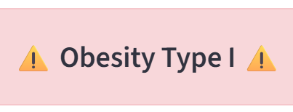
Application Workflow
24
User input parameters
Execute (Press button)
Model Processing
Display Result

Slide 25
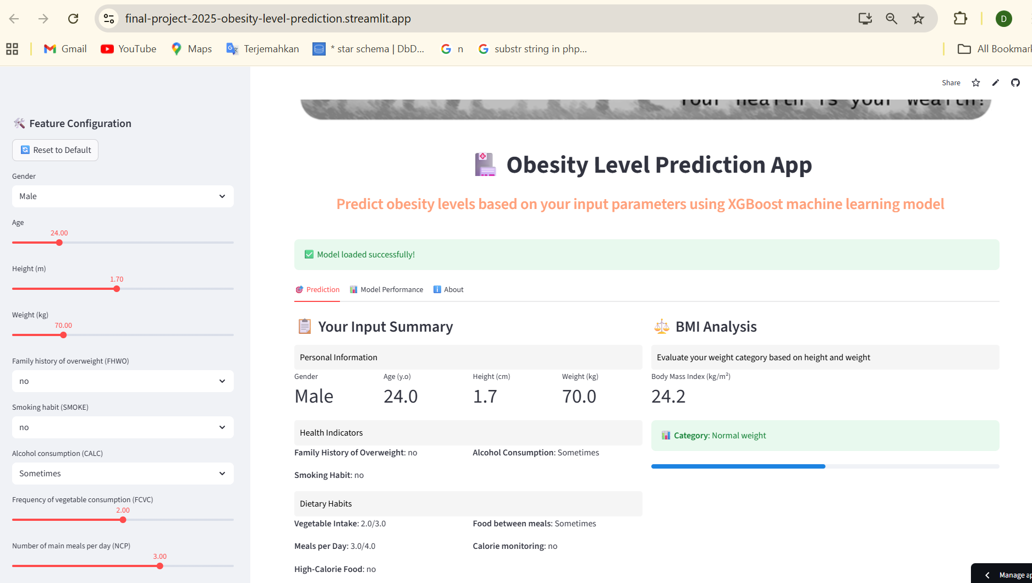
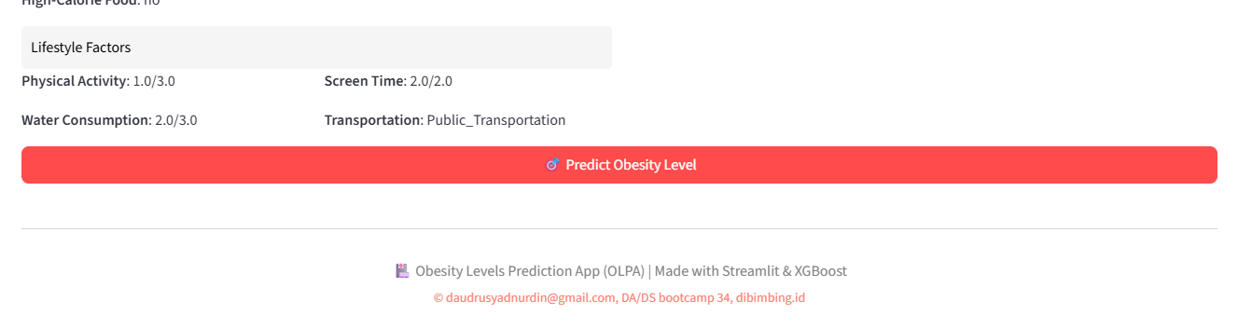
Obesity Level Prediction App
25
1
Input parameter here
2
Press this red button

Slide 26
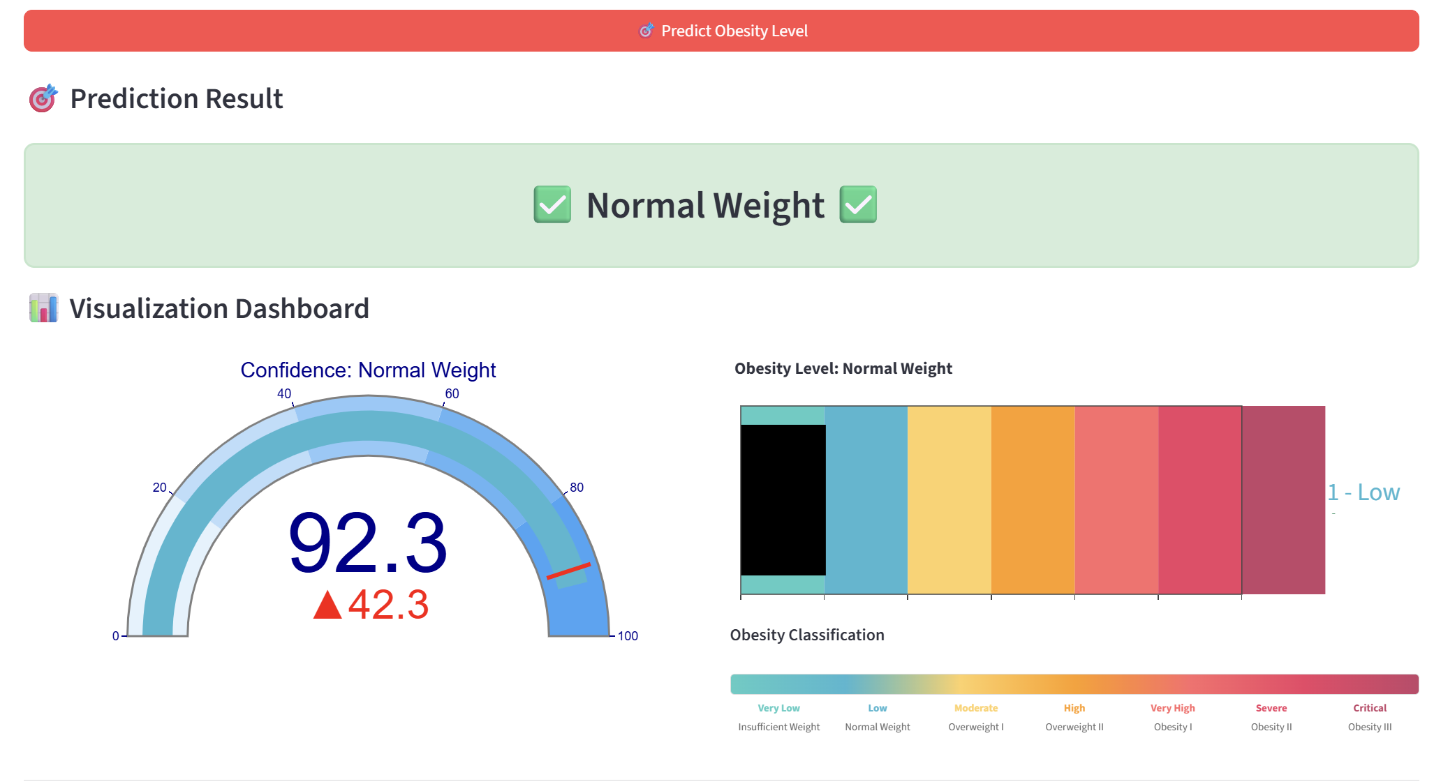
Obesity Level Prediction App
26
3
Check the result here

Slide 27
Conclusions
27
The Logistic Regression model is suitable to be used as a baseline model because it provides a simple yet effective approach to classification problems.
From the results of training, testing, tuning, and evaluation, the tree-based models generally show good performance in predicting obesity levels.
Based on the results of training, testing, and evaluation, XGBoost is the most appropriate model for predicting obesity levels.
Streamlit is easy to use framework, enabling us to develop machine learning–based applications more quickly and efficiently.

Slide 28
Business Insight
28
In general, the models indicate that Weight, Height, Age, and Gender are the primary factors contributing to obesity. These variables consistently showed strong correlations with obesity levels across multiple model evaluations.
Furthermore, the XGBoost model — which was selected as the best-performing algorithm due to its high predictive accuracy and computational efficiency — identified several additional key determinants of obesity, namely:
✅ Frequency of vegetable consumption.
✅ Consumption of high-calorie foods
✅ Frequency of snacking
✅ Frequency of alcohol consumption
✅ Family history of obesity
✅ Transportation habits
✅ Number of meals per day
These findings suggest that, in addition to physical attributes, lifestyle, behavioral, and genetic factors collectively play a crucial role in determining obesity risk.

Slide 29
Thank you!

